Slide 1
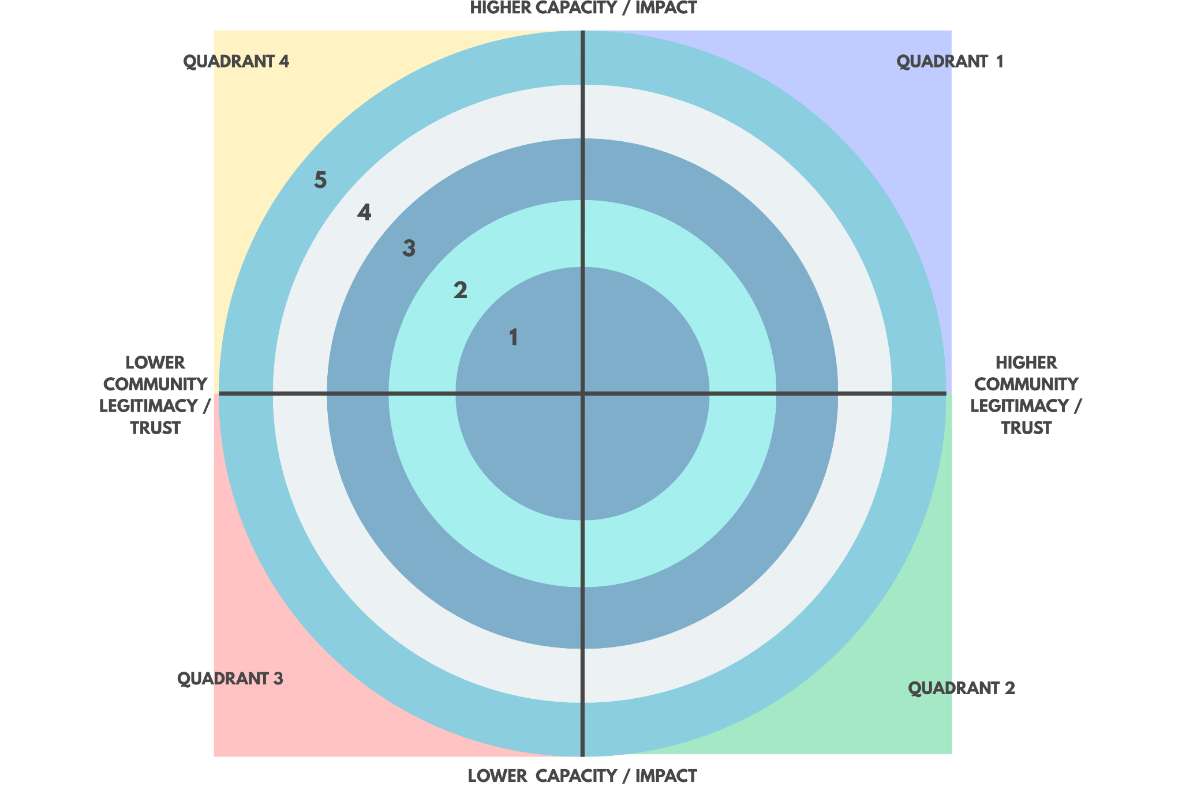
[Community Name]
Quadrant 1 Partners
Quadrant 2 Partners
Quadrant 4 Partners
Ring 1 Partners
Ring 2 Partners

Slide 2
Where Should We Focus?
Look for “Community Centers of Power” - orgs & spaces that demonstrate…
Accountability
Responsive to the people they claim to represent
Part of the community fabric - not serving “from above or below”
Reflective of the full diversity of the community
Belonging
Anyone can take part & feel like they are welcome
Everyone can access all parts of the work / space
Central to the community fabric / life
Co-Creation
People help make things together & retain the value of what’s made
Anyone can help set the agenda or participate in leadership
Adaptive to new participants, challenges, and opportunities

Slide 3
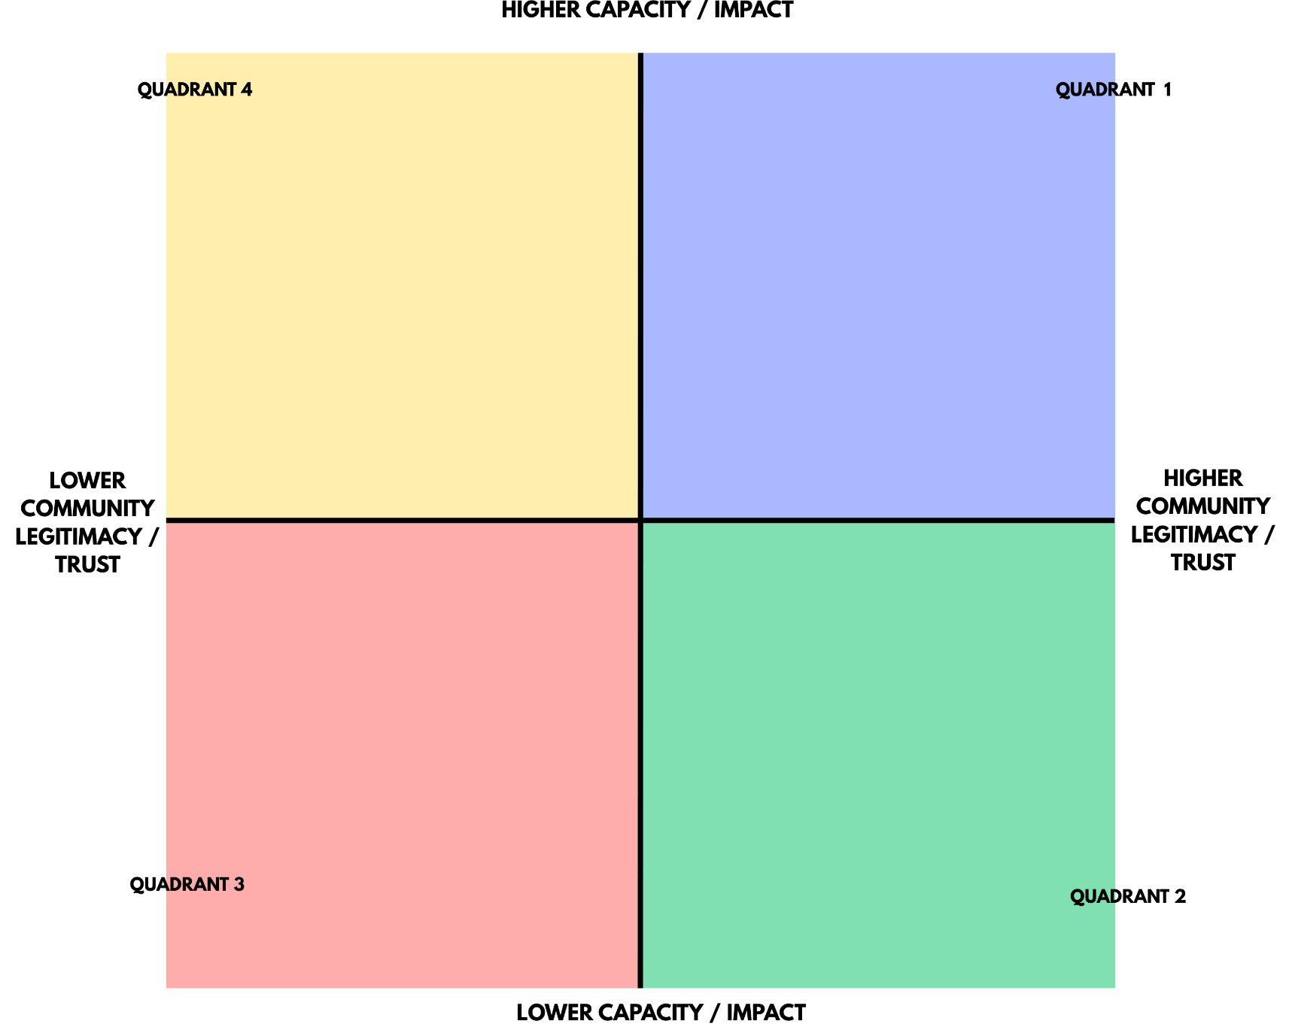
Prioritizing Potential Partners
Choose a quadrant based on the following:
How much trust or legitimacy does
the org or partner already have?
How much of an impact does their
work have?
How much capacity do they have
to do their work (and/or new work)?

Slide 4
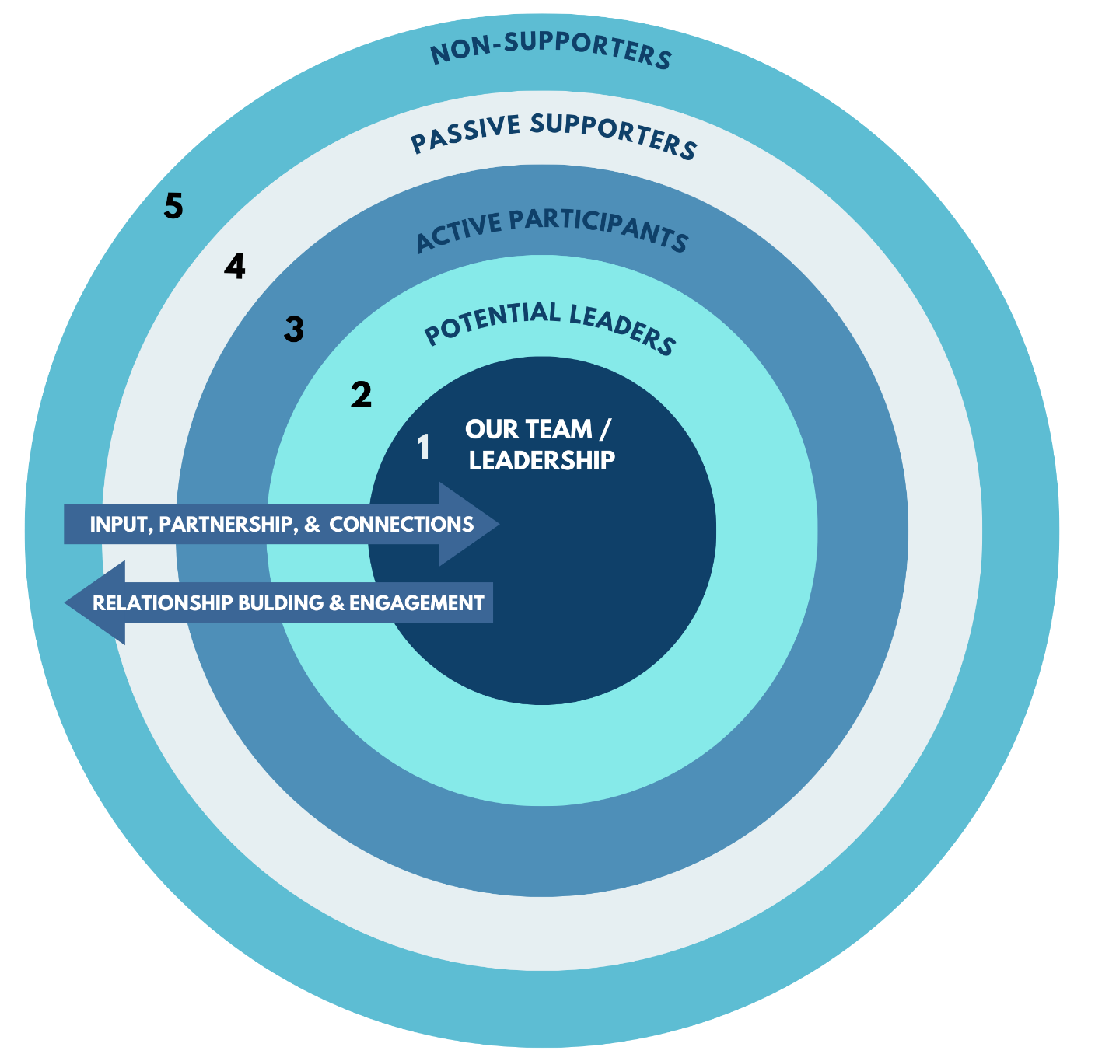
Assessing Alignment
Choose a“ring” based on how well they align with our values & self-interests:
1. Core Leaders: take responsibility for leading and guiding the organization, its work, and its people.
2. Very Aligned / Potential Leaders: people who are active participants and also take on some leadership tasks, but would not (yet?) participate as full leaders.
3. Somewhat Aligned / Active Participants: people who participate reliably in specific projects, activities, and/or events when asked, but would not (yet?) participate in leadership.
4. Mixed Alignment / Passive supporters: people who claim to support the organization and its work, but cannot or would not (yet?) participate reliably.
5. Unaligned / Non-Supporters: people who do not (yet?) support the organization and its work.

Slide 5
Mapping Your Community
Combine the tools and prioritize
partners accordingly
Choose the quadrant first
Then plot them based on
the “rings”
Prioritize your outreach and
engagement based on the map

