Slide 1
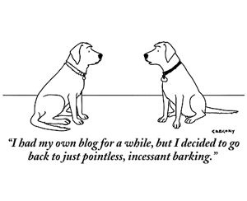
Better Blogging Duncan Green

Slide 2
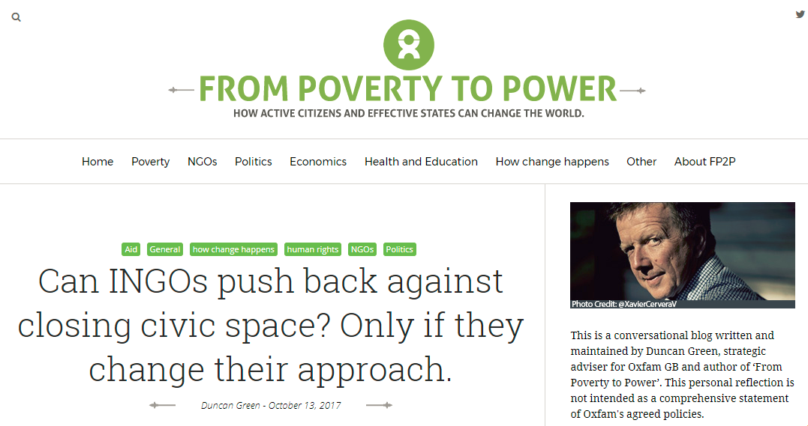
This is me
But how about you?
Who’s written a blog before? How was it?

Slide 3
What is a blog?
A web log
= a diary
= an informal chat with friends and/or yourself
So write like you talk (the hardest thing for academics – imagine a specific, intelligent non-academic friend. If you have any.)

Slide 4
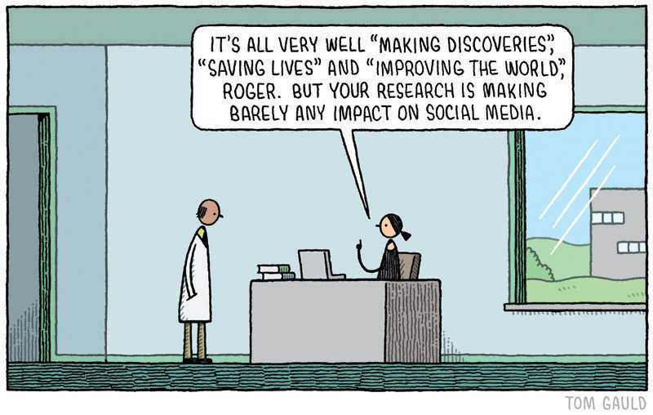
Why blog? Evidence from World Bank
‘Blogging about a paper causes a large increase in the number of abstract views and downloads in same month’.
These increases are massive compared to the typical abstract views and downloads these papers get - one blog post in Freakonomics is equivalent to 3 years of abstract views.’

Slide 5
Other Benefits
Makes you think harder
Career: networking and profile
Archive of your thinking
Free books (aka review copies)

Slide 6
Style: Do’s and Don’ts
Jump between writer and reader – you have to be in both places
Love the reader – reach out to them; don’t be scared
Interact: reply to comments, run polls.
Be human: Ask questions, admit confusion and doubt, be funny if that’s your thing
Don’t be pompous – never say ‘Oxfam/LSE thinks/believes’; ‘the IMF must…. etc’!
And above all, avoid…..

Slide 7
The curse of devspeak
Oxfam has promised us
“appropriate agricultural
inputs and extension services…”
But we just want
seeds, tools and
good advice.
Notes:
Aim to cut the jargon out of your writing or, at the very least, explain it to the reader. Similarly, be careful that your use of acronyms doesn’t alienate the reader. Either spell it out in full in the first instance, include a list of acronyms, or don’t use them at all.

Slide 8
Generating content: 10 ways to Write a Draft Post in under an hour
Why? Because you’re busy, and writing fast makes for better posts
You’re already sitting on dozens of potential posts from
Stuff you’re already doing
Stuff you’re are already reading (or want to)
Trips to interesting places
Having Fun

Slide 9
Stuff you’re already doing
Powerpoints are basically blog posts
Memorable insights and conversations (water cooler, arguments) – spy on your shoulder
A way to make meetings endurable (Chatham House is your friend)
Put up drafts for comment (good promo and improves your paper)

Slide 10
Stuff you’re are already reading (or want to)
Grey Literature: Skim, (Exec) Sum, link and spin
Book Reviews
Good Graphics

Slide 11
Trips to interesting places
the field trip conversation or Back to Office report
Get the phone out record a podcast or vlog!

Slide 12
Having Fun
Use twitter or beer convos to generate listicles and funnies

Slide 13
Structure & Decoration
The title is the gateway – work on it
People jump out quickly, so no throat clearing – identify the Big Idea in first para
Less is more (same reason) 500 – 1200 words
Graphics, cartoons, photos
Links save space and people appreciate them (avoid footnotes)
Short paras

Slide 14
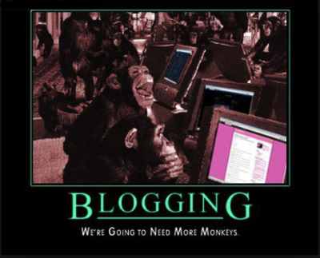
Enough Talk
Time for Action: Over to you!

